Slide 1
Module 3.2: Nearest Neighbors, Decision Trees and Random Forest
Dennis J. Zhang
Washington University in St. Louis

Slide 2
Statistical Learning Models
Models:
K Nearest Neighbors
Decision Tree
Random Forest
For each model:
Algorithm
Implementation
Optimization/Tuning

Slide 3
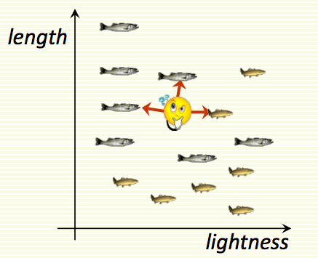
K Nearest Neighbors
Classify an unknown example with K common class among k closest examples.
Example:
K = 3

Slide 4
K Nearest Neighbors

Slide 5
K Nearest Neighbors
Distance Metric:
L1 distance
L2 distance
Time Complexity:
Training/Estimation: O(1)
Classification: O(d * n * k)
What is the problem? How to improve?
How to choose K?

Slide 6
K Nearest Neighbors
Some implementation guidance:
In general, p-norm penalizes one bad dimension much more than (p-1)-norm. Choose your distance metric for your particular case.
When N is large, preprocess the data first.
When d is large, use feature selection method, such as PCA.
Choose k based on cross-validation.

Slide 7
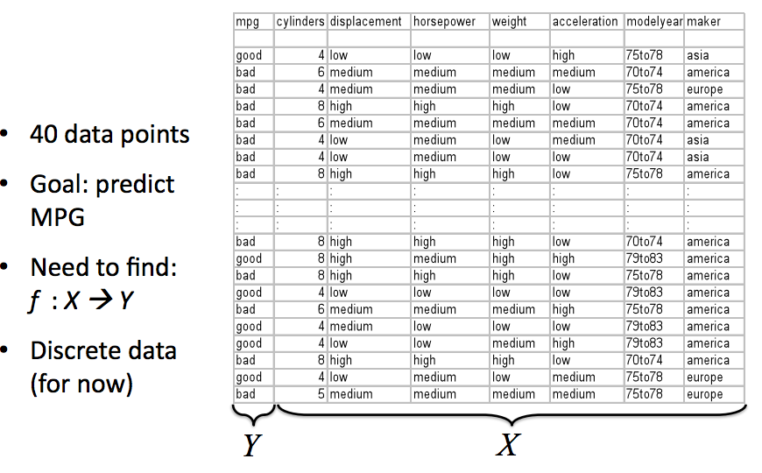
Decision Tree

Slide 8
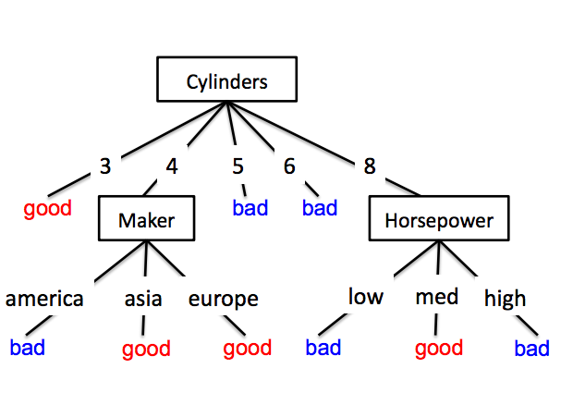
Decision Tree
Each internal node is an attribute.
Branches based on attributes
Each leaf assigns one y.
Benefits:
Human interpretation
Large space of functions

Slide 9
Decision Tree
Estimation: How to estimate a decision tree?
The number of possible trees is exponential in the number of attributes.
Learning the best decision tree is NP-complete (Hyafil & Rivest 1976)
What can we do?
Heuristics!
Start from an empty tree.
Split on the next best attribute until deplete all attributes.

Slide 10
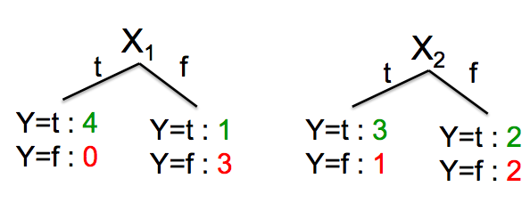
Decision Tree
What is the best attribute/split?
A split is better if we are more certain about classification after split.
Example: If after the split, you know all variables in each branch have the same y, the split is good. If Y is uniformly distributed after the split, it is then bad.

Slide 11
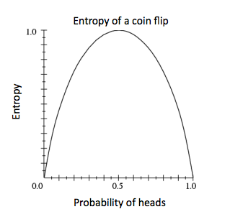
Decision Tree
Definition of a good split (Entropy):
What is the information gain on X?

Slide 12
Decision Tree

Slide 13
Decision Tree
Some Tips:
Decision trees tend to overfit! (why?)
Using PCA or other feature selection methods to select features before constructing your tree.
Give a lower bound on the number of samples in each leaf. (If the number is too small, the tree may be overfitting).
Balance your data before training. (If Y = A for 99% of time, you probably want to down-sample Y = A cases to create a more balanced dataset).

Slide 14
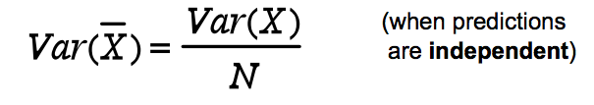
Bagging (Bootstap aggregation)
Decision trees tend to overfit. So how to solve this?
Averaging reduces variance (pooling…):
Average models to reduce the variance of predictions.
However, we only have one training set…. How could we construct multiple models?

Slide 15
Bootstrapping
Given a dataset of size m, a bootstrap sample is created by sampling m instances uniformly from the data (with replacement).
Since (1 – 1/m)^m is approximately exp(-1) = 0.368, each sample point in the original data set has 0.632 probability to be sampled.
Bootstrapping is a general approach to statistical inference based on building a sampling distribution for a statistic by resampling from the data at hand (Efron (1979))
Bootstrapping is very useful when the estimator’s variance has no closed-form equation:
Machine Learning models
Structural Estimation
Difficult reduced-form clustered standard errors.

Slide 16
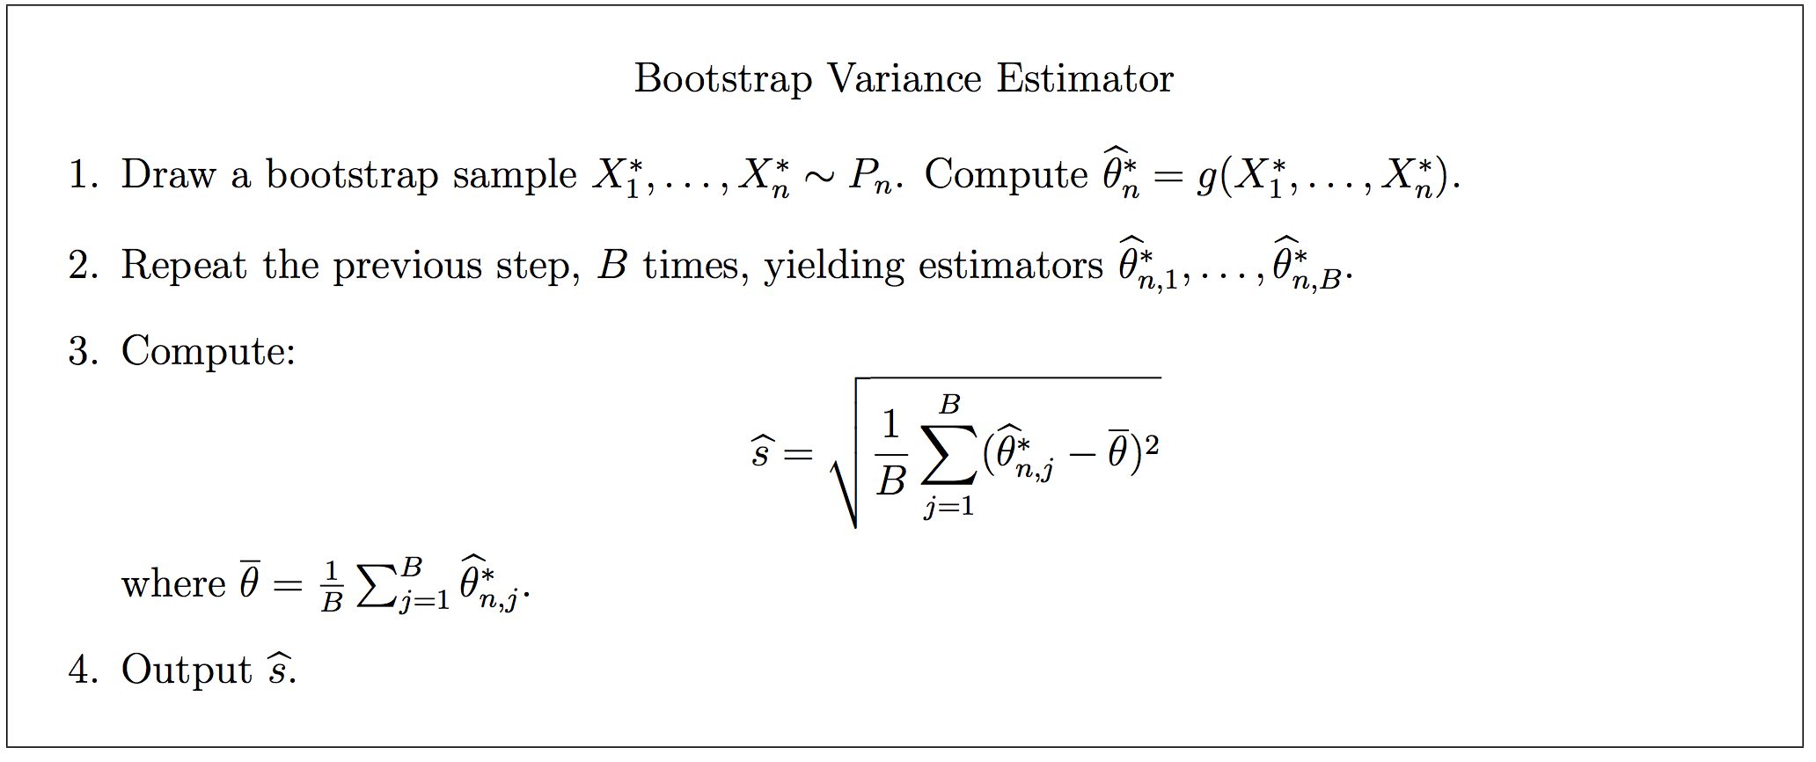
Bootstrapping Variance Estimator
Notes:
Under appropriate regularity conditions, s^2/Var(θ) → 1 as n → ∞ in probability

Slide 17
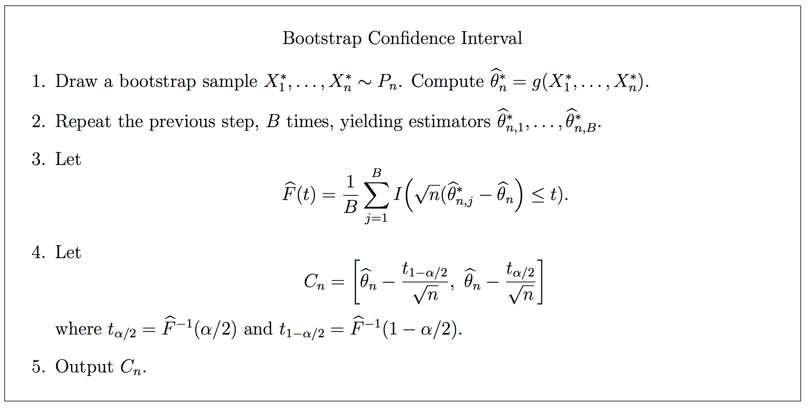
Bootstrapping Confidence Interval Estimator
Notes:
Under appropriate regularity conditions, P(θ ∈ Cn) = 1 − α − O (1/√ n). as n → ∞.

Slide 18
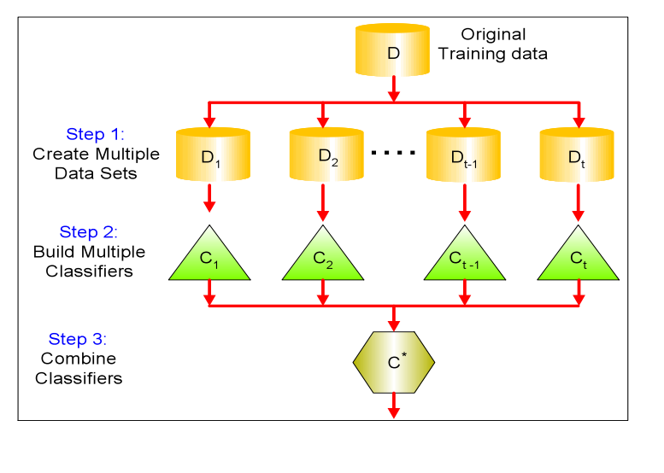
Bagging
Bagging or Bootstrap Aggregation (Breiman, 1994):
Fit many large trees to bootstrap-resampled versions of the training data and classify by majority vote.
The 0.632 bootstrap:

Slide 19
Random Forest
Random Forest is a fancier version of bagging for decision trees:
Introduce two sources of randomness:
Bagging: each tree is grown upon a bootstrap sample of training data.
Random vector: For each tree at each node, best split is chosen from a random sample of m attributes instead of all attributes
Why? Consider there is a very strong predictor

Slide 20
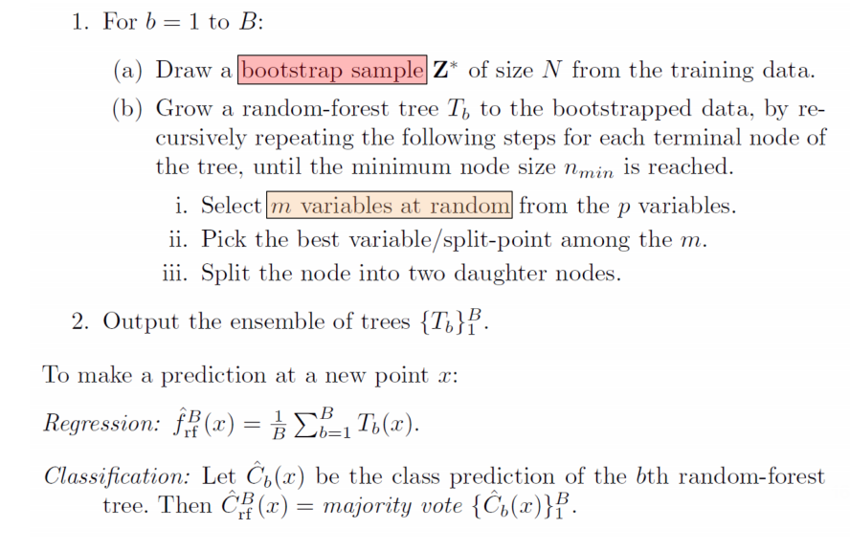
Random Forest

Slide 21
Random Forest
Are two sources of randomness enough?
It turns out no…
Extremely Randomized Trees!
Third source of randomness:
The threshold which generates the split is randomly chosen (instead of choosing the most discriminative one).
This algorithm is faster.
It is more robust to misspecification of models or variance in data.

Slide 22
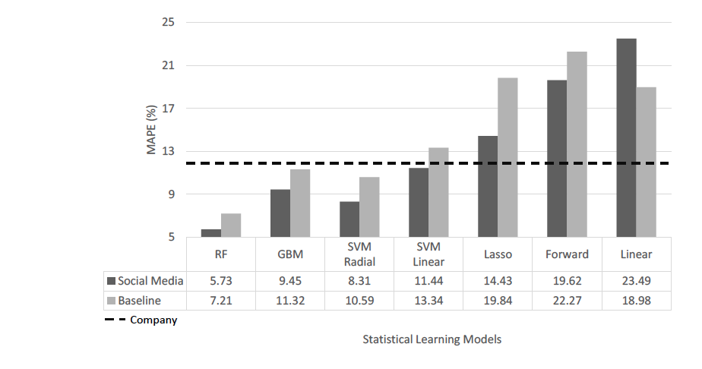
Random Forest

Slide 23
Boosting
Like bagging, boosting is a general approach that can be applied to many statistical learning methods.
Boosting works in a similar way as bagging does. The only difference is that the trees are grown sequentially: each tree is grown using information from previously grown trees.

Slide 24
Boosting

Slide 25
Boosting
Fitting each tree sequentially
Each tree will be very small (d+1 terminal nodes)
Observations that are predicted wrong before will be weighted more in the future.
In this way, we slowly improve the final function f. And each tree is different.

